Slide 1
Eye on Surveillance
EOS
Analysis of NOPD’s Surveillance Data Requests to the Real-Time Crime Center

Slide 2
Data Overview
500k Electronic Police Reports produced between 2018 – 2022
26k of them are associated with a request for data from the RTCC center
Electronic Police Reports contain info on: 'charge_description', 'offender_race', 'district', 'location', 'offender_gender', 'offender_age', 'disposition', 'signal_type', 'signal_description', 'occurred_date_time', 'charge_code', 'offender_number', 'person_type', 'victim_race', 'victim_gender', 'victim_age', 'victim_number', 'victim_fatal_status', 'hate_crime', 'report_type', 'year', 'offenderid', 'offenderstatus', 'persontype', 'Signal Code',

Slide 3
Data Overview
What we know so far:
When accused of the same crime, for example Armed Robbery, NOPD is 2x likely to request RTCC data for a black person accused of the crime.
The same holds true for Illegal Possession of Stolen Things where NOPD is 3x as likely to request RTCC data for a black person accused of the crime.

Slide 4
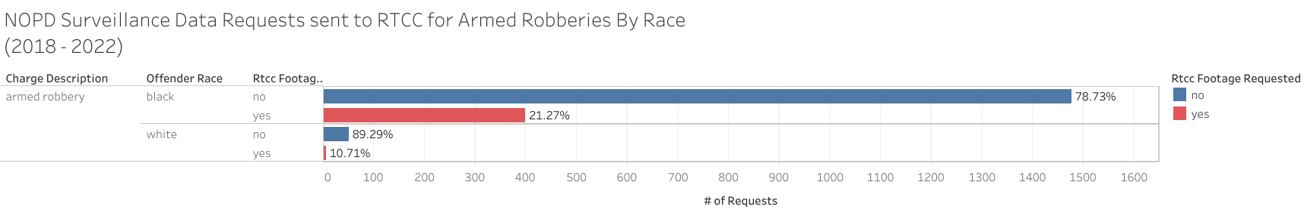
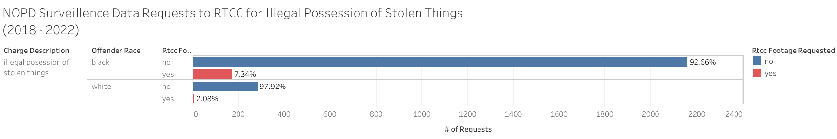
Police Report Data

Slide 5
Data Overview
What we know so far:
Open police reports associated with an RTCC request increased from 2020 to 2021.

Slide 6
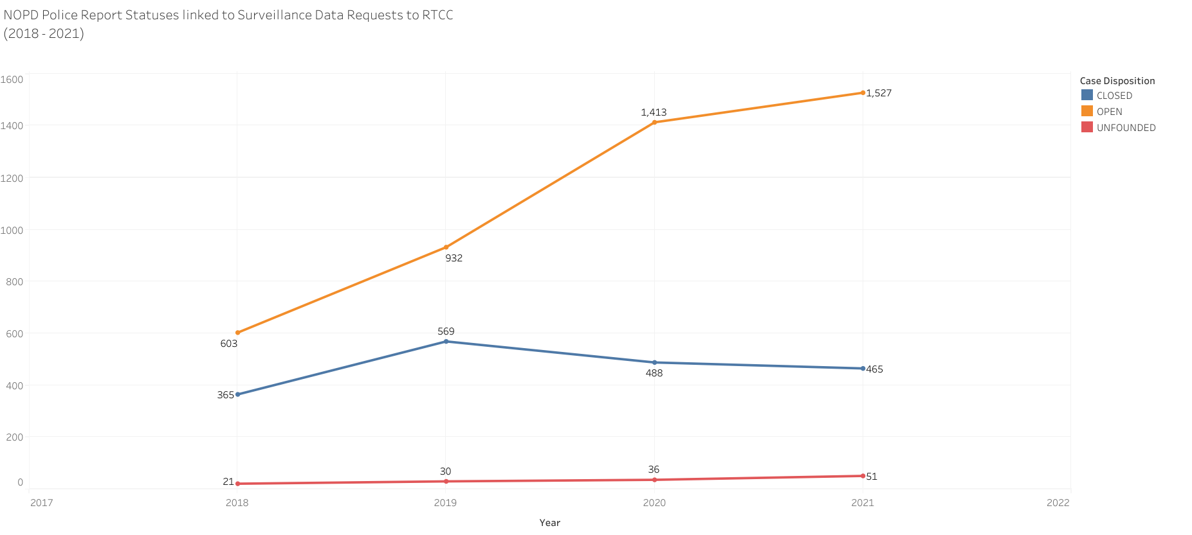
Police Report Data

Slide 7
Data Overview
What we know so far:
Most common type of charges associated with RTCC requests

Slide 8
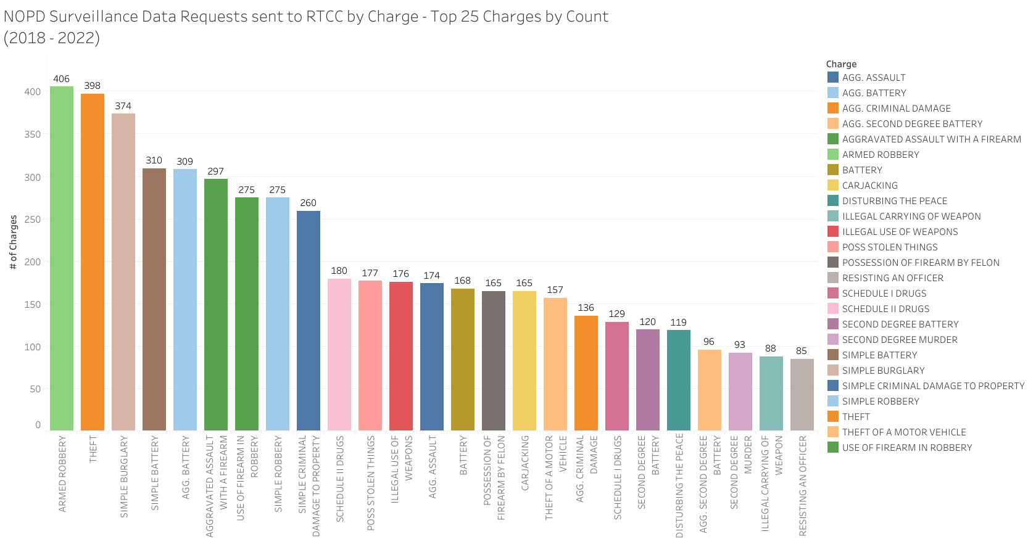
Police Report Data

